Slide 1
Sorting Soil
Name
Date

Slide 2
About Me
Where I work
Job title
A little about me
Notes:
Hi, my name is __________________ and I work for ___________________ doing ____________________.
Introduce a little about yourself (Ex. You can share the town you live in, school you attended if local, highlight of the grade of the classroom you are in to make yourself relatable, something about your family, hobbies).
We will talk a little more about my career later.

Slide 3
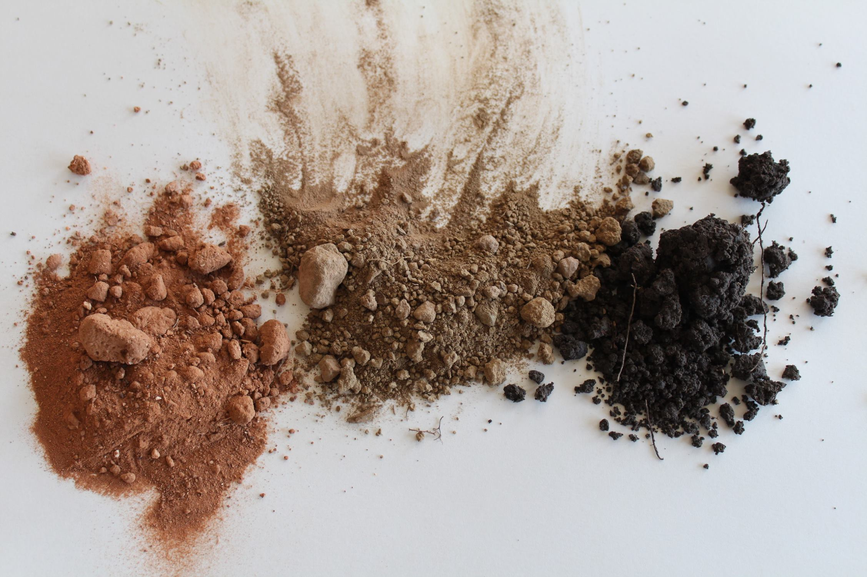
Notes:
Not all soil is created equal! Even soil that looks similar can be very different. Soils contain different properties and different nutrients that plants use. Today we are going to take a closer look at differences you can see in the soil, including organic and inorganic material.

Slide 4
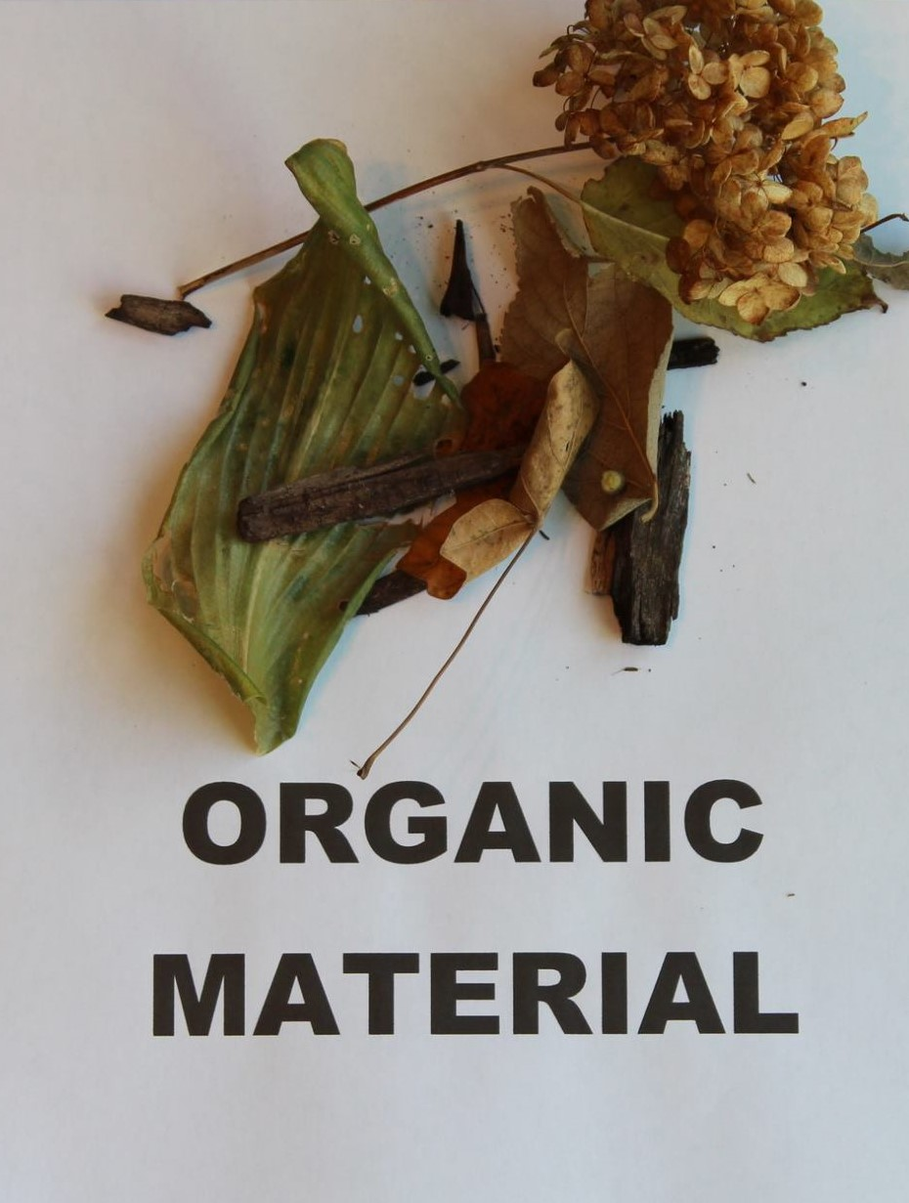
What is Organic Material?
Material from living or once living organisms.
Dead plant material, worms or decomposing insects
Notes:
Let’s start with organic material. What does that mean?
Materials from living or once living organisms can be called organic matter. Some examples of this are dead plant material, worms, or decomposing insects.

Slide 5
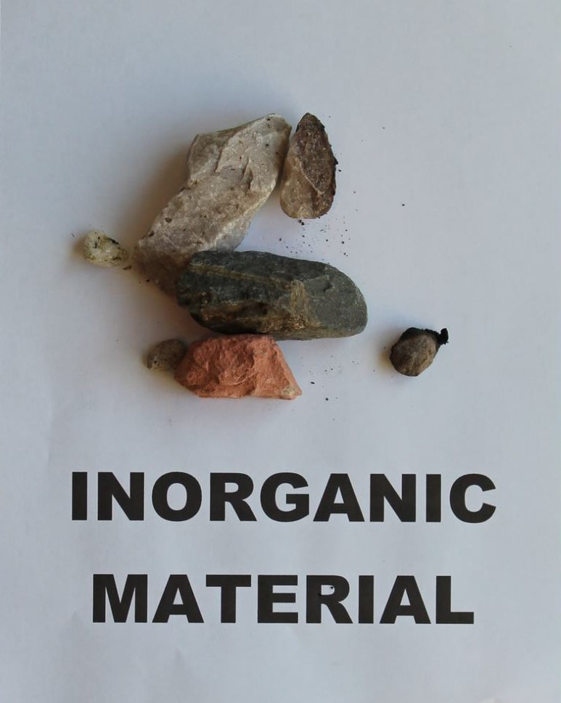
What is Inorganic Material?
Non-Living materials
Clay, rocks or sand
Notes:
So what do you think inorganic material would be?
Some examples of inorganic materials would be non-living materials such as clay, rocks, or sand.

Slide 6
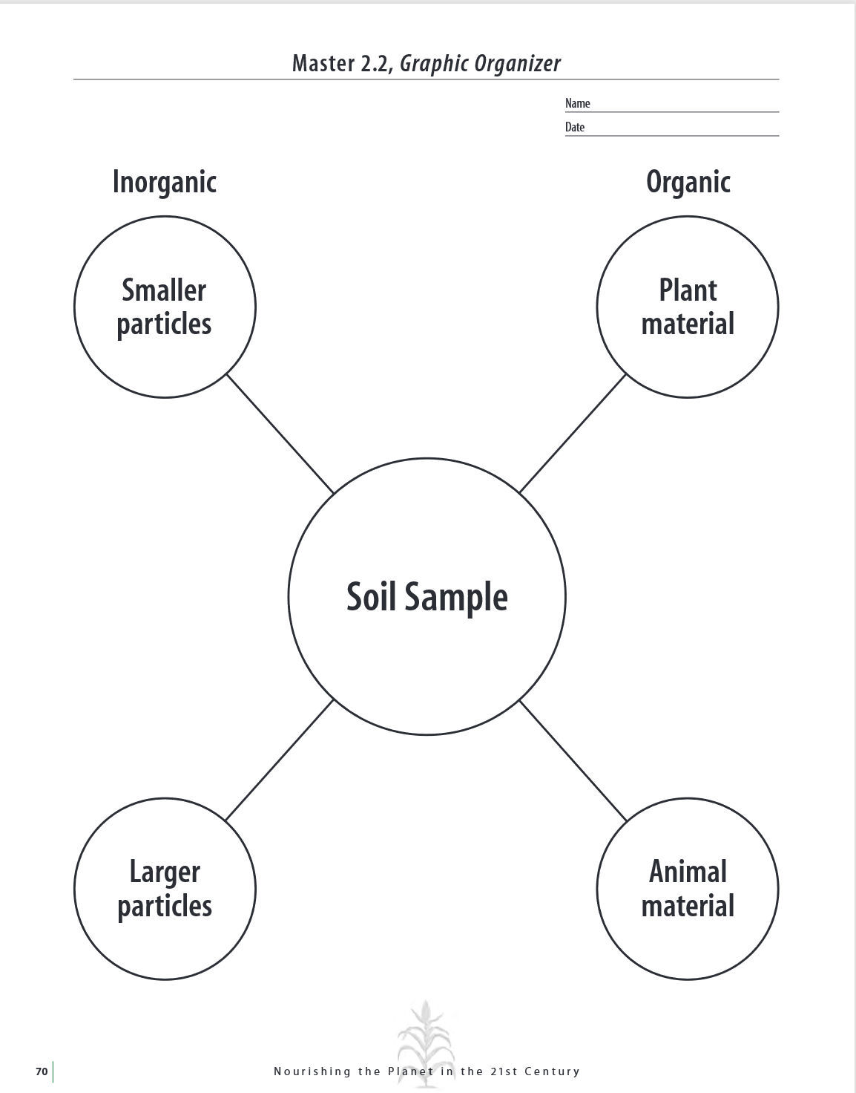
Notes:
Today you are going to be sorting soil. We are going to break up into groups of 2 or 3 now, so take a minute to get with your partner or group.
**Hand one printout to each group and place one spoonful of soil in the center of the handout.
Take a few minutes to sort your soil into the four categories on your handout, Non-living large pieces, nonliving small pieces, living large pieces and living small pieces.
**Students can use a magnifying glass if available.
**Items needed
Soil sample (this can be from a field, lawn or garden)
** Optional – can also give different groups different types, some groups can have local soil, some potting soil and some sand. You will then be able to discuss the differences.
Printout with the diagram for sorting (add print link)
Optional magnifying glass
Time: 10 minutes

Slide 7
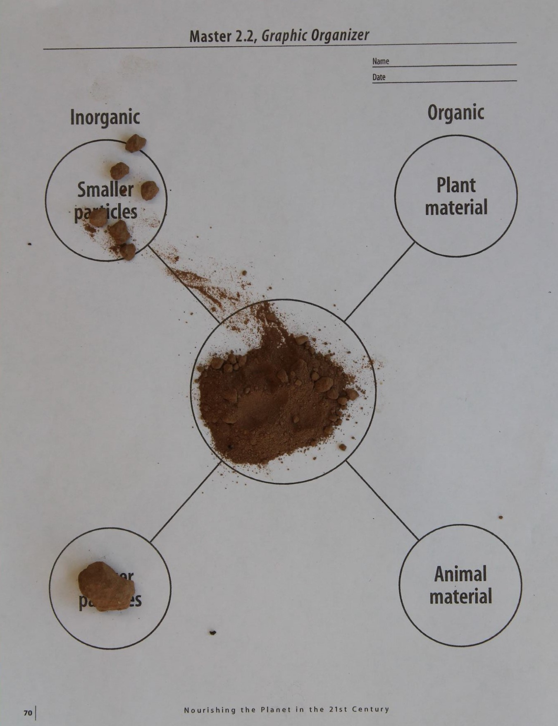
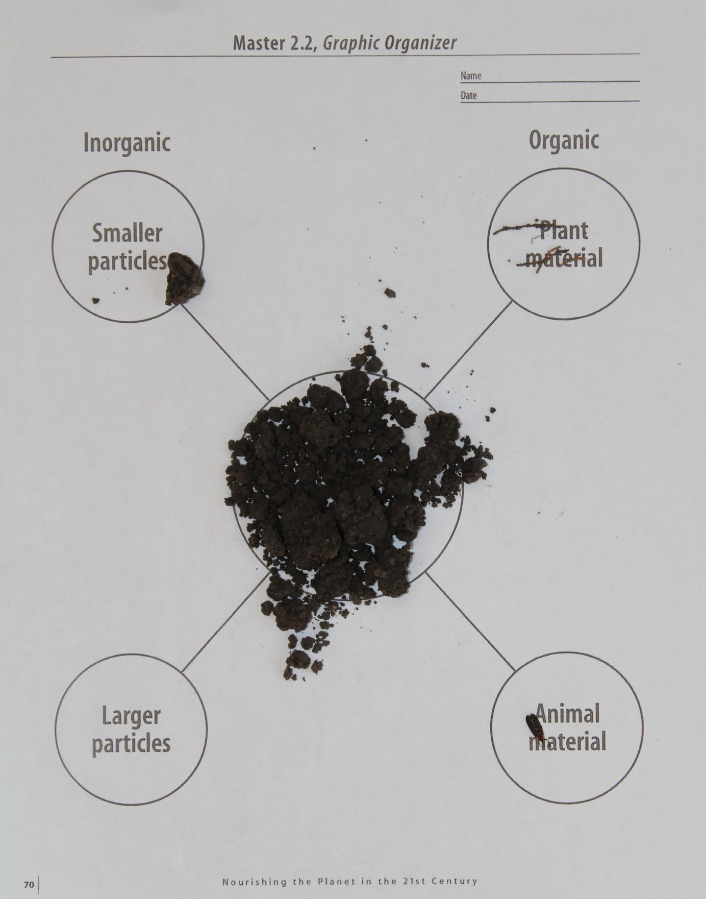
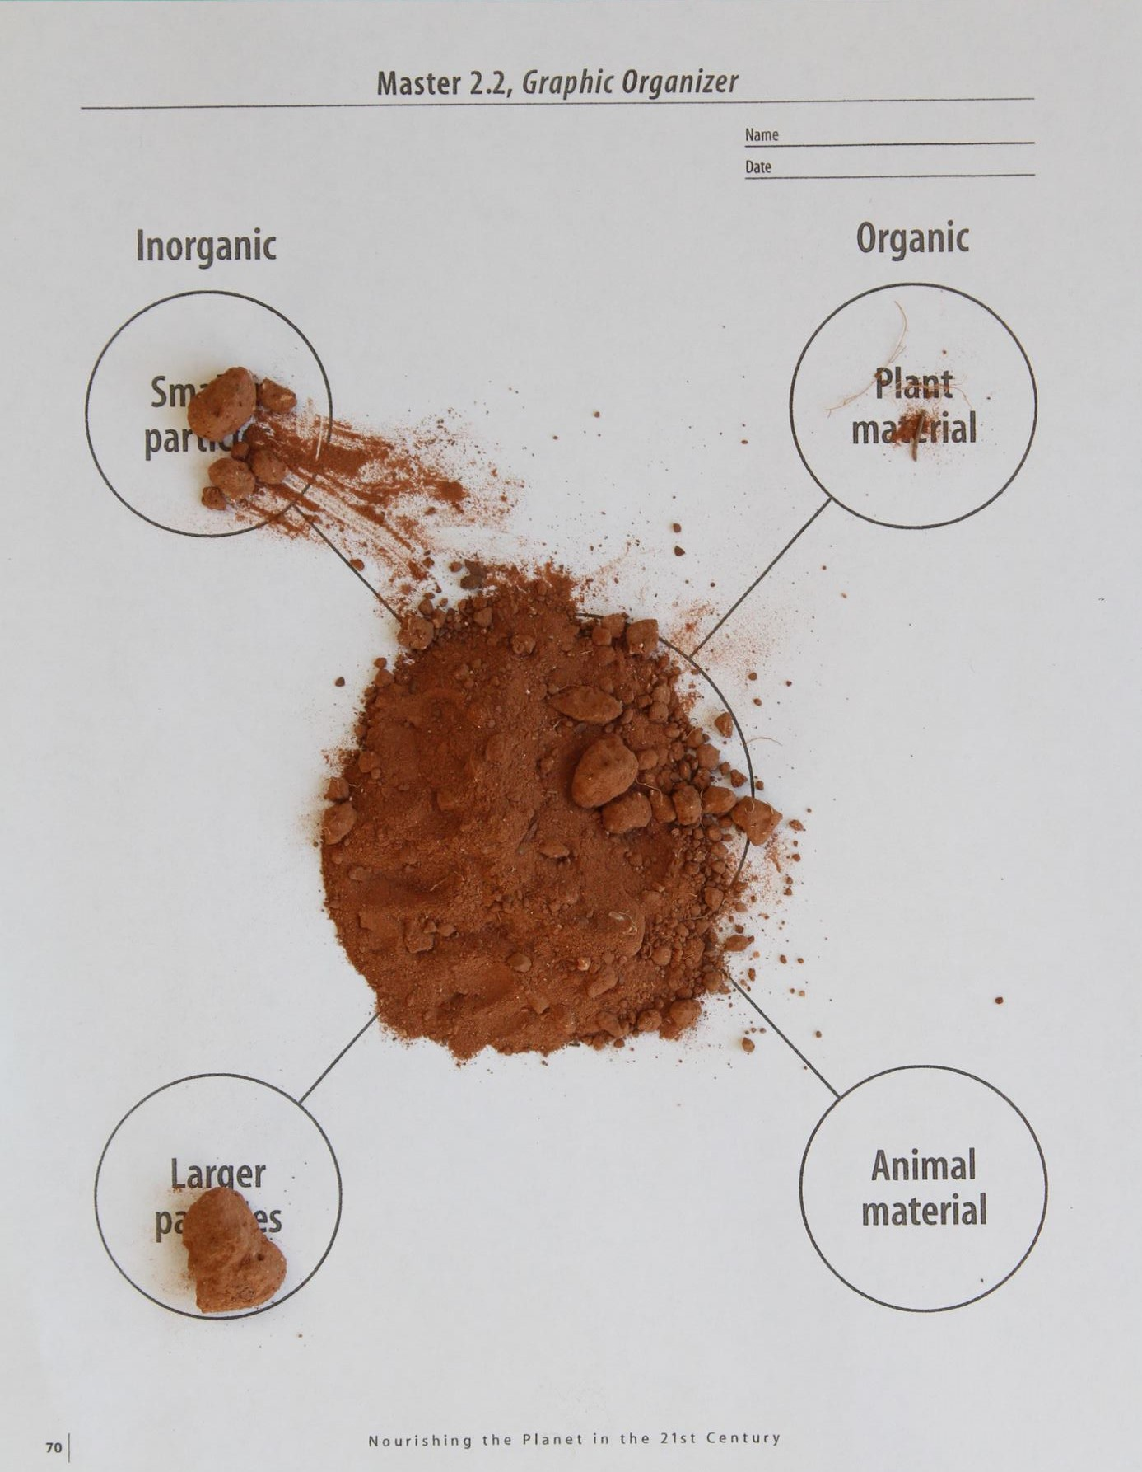
Notes:
Hold a discussion about observations:
Ask students to share what they found in their soil samples.
What was something you found interesting in the sample?
What are some examples of pieces of organic matter that were found?
What are some examples of inorganic matter that were found?
** Optional, if you gave out local soil, potting soil and sand, discuss the differences and ask student what type of material they thought they had.
As you can see from this activity, soils differ in their composition. The soils contain organic and inorganic materials. Visual inspection gives you an idea that soils are different but does not fully evaluate everything about soil. There are some things in the soil that you cannot see.

Slide 8
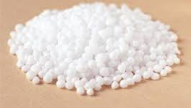
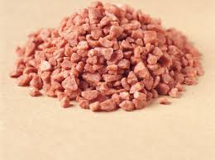
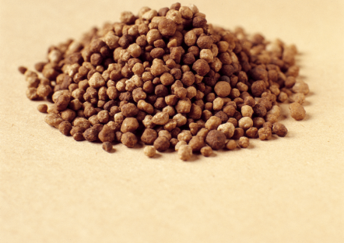
Potassium
Nitrogen
Phosphorus
Notes:
Nutrients are naturally occurring in the soil, but you can’t see them! In order to determine what nutrients are in the soil, you must take a soil sample and send it to a lab to determine what nutrients are present. This allows farmers to determine what type and amount of fertilizer needs to be added to the soil to grow healthy crops.
Take a look at this slide, it is showing what Nitrogen, Phosphorus and Potassium look like when they are added to the soil as fertilizer.

Slide 9
Add some pictures of you doing your job/ the facility you work in.
Notes:
We talked a little earlier about my job title, but what is it that I actually do, and how does it relate to what we just learned about soil?
** Spend some time talking about your career, how it relates to Agriculture and the fertilizer industry. What do you do on a daily basis? What kind of education is needed to have a job like yours? Feel free to add additional slides and pictures to better explain your career.

Slide 10
QUEStionS?
Notes:
Ask students if they have any questions. You may also add contact information if you would like to be available to answer additional questions.

